Slide 1
Bridge Surveys
James Peak and Indian Peaks Wilderness Areas

Slide 2
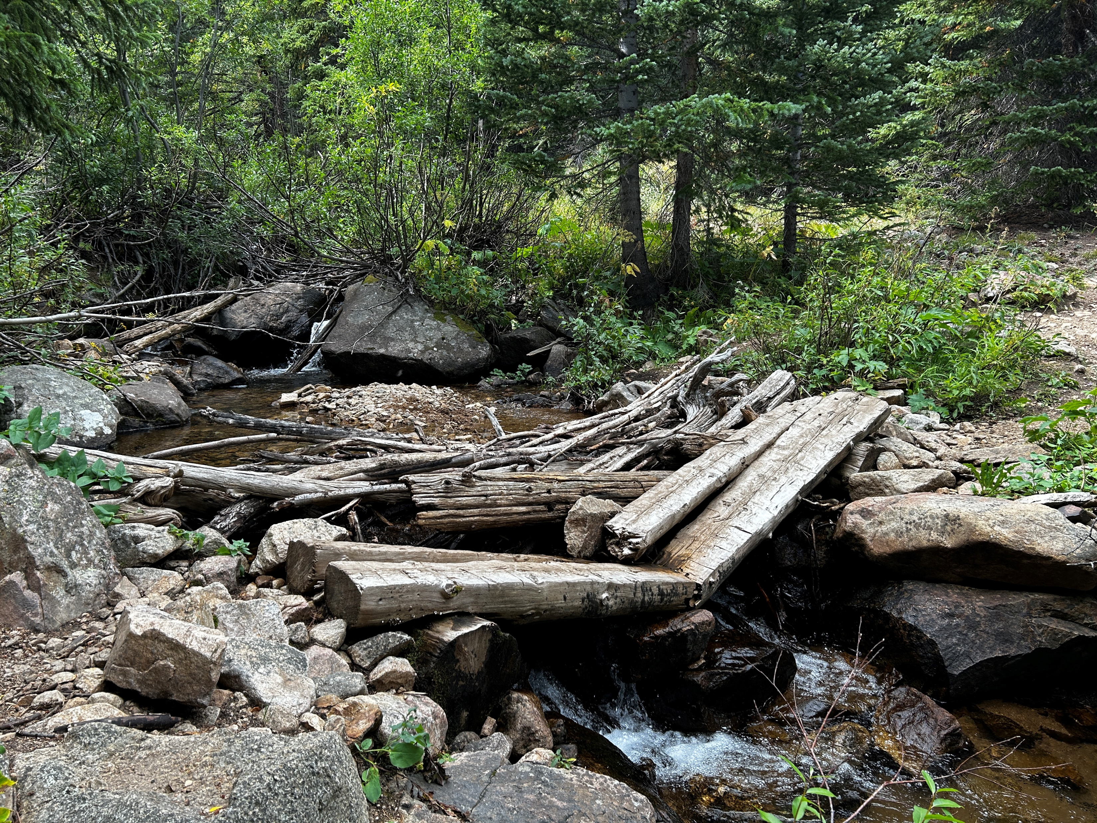
Trail Bridges in Wilderness
Normally not too many bridges in wilderness areas, generally just over major crossings
IPW and JPW are extremely high use, and not having bridges would ultimately do more damage
People will stack up logs/sticks to pass, which can dam up the stream and make the crossing much wider and divert the stream down the trail.
FS categorizes trail bridges as minor, major, and complex depending on their length, construction material and complexity.

Slide 3
Trail Bridge Terminology
Approach – sections of trail on either side of a trail structure. Approaches rise from the trail tread to meet the decking. Can either be a ramp or a step.
Bridge Substructure – Foundation of bridge that includes abutments and piers.
  Sill/Abutment/Footer – Single Element foundation placed on a compacted fill that supports bridge superstructure.
  Pier – Intermediate bridge supports, can be made of a timber frame or rock cribs
  Backwall – Small retaining wall at ends of the bridge that supports the approach slab and holds back the embankment from impacting the bridge
Bridge Superstructure – Carries the loads from the deck to the substructure
  Stringers – Beams that run under the deck of a bridge and rest on the abutments on either side of the crossing. Can be made of hewn logs, sawn timber, or metal beams.
Decking – Supports live loads and transfers the weight to the superstructure
User Barriers – Curbs and railings, look @ TMO for guidance on what kind of barrier is needed, if any.

Slide 4
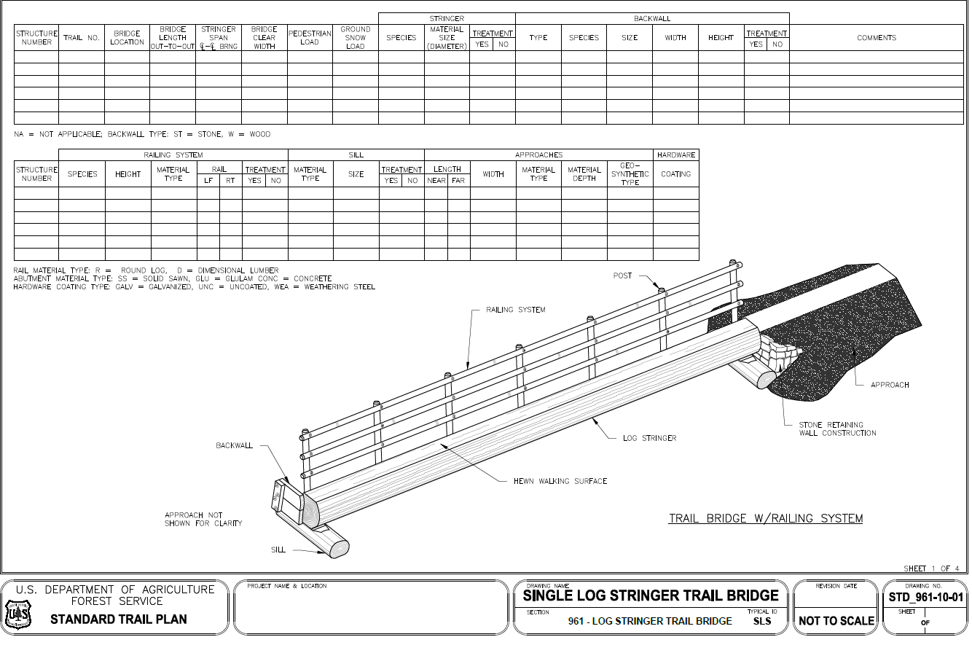

Slide 5

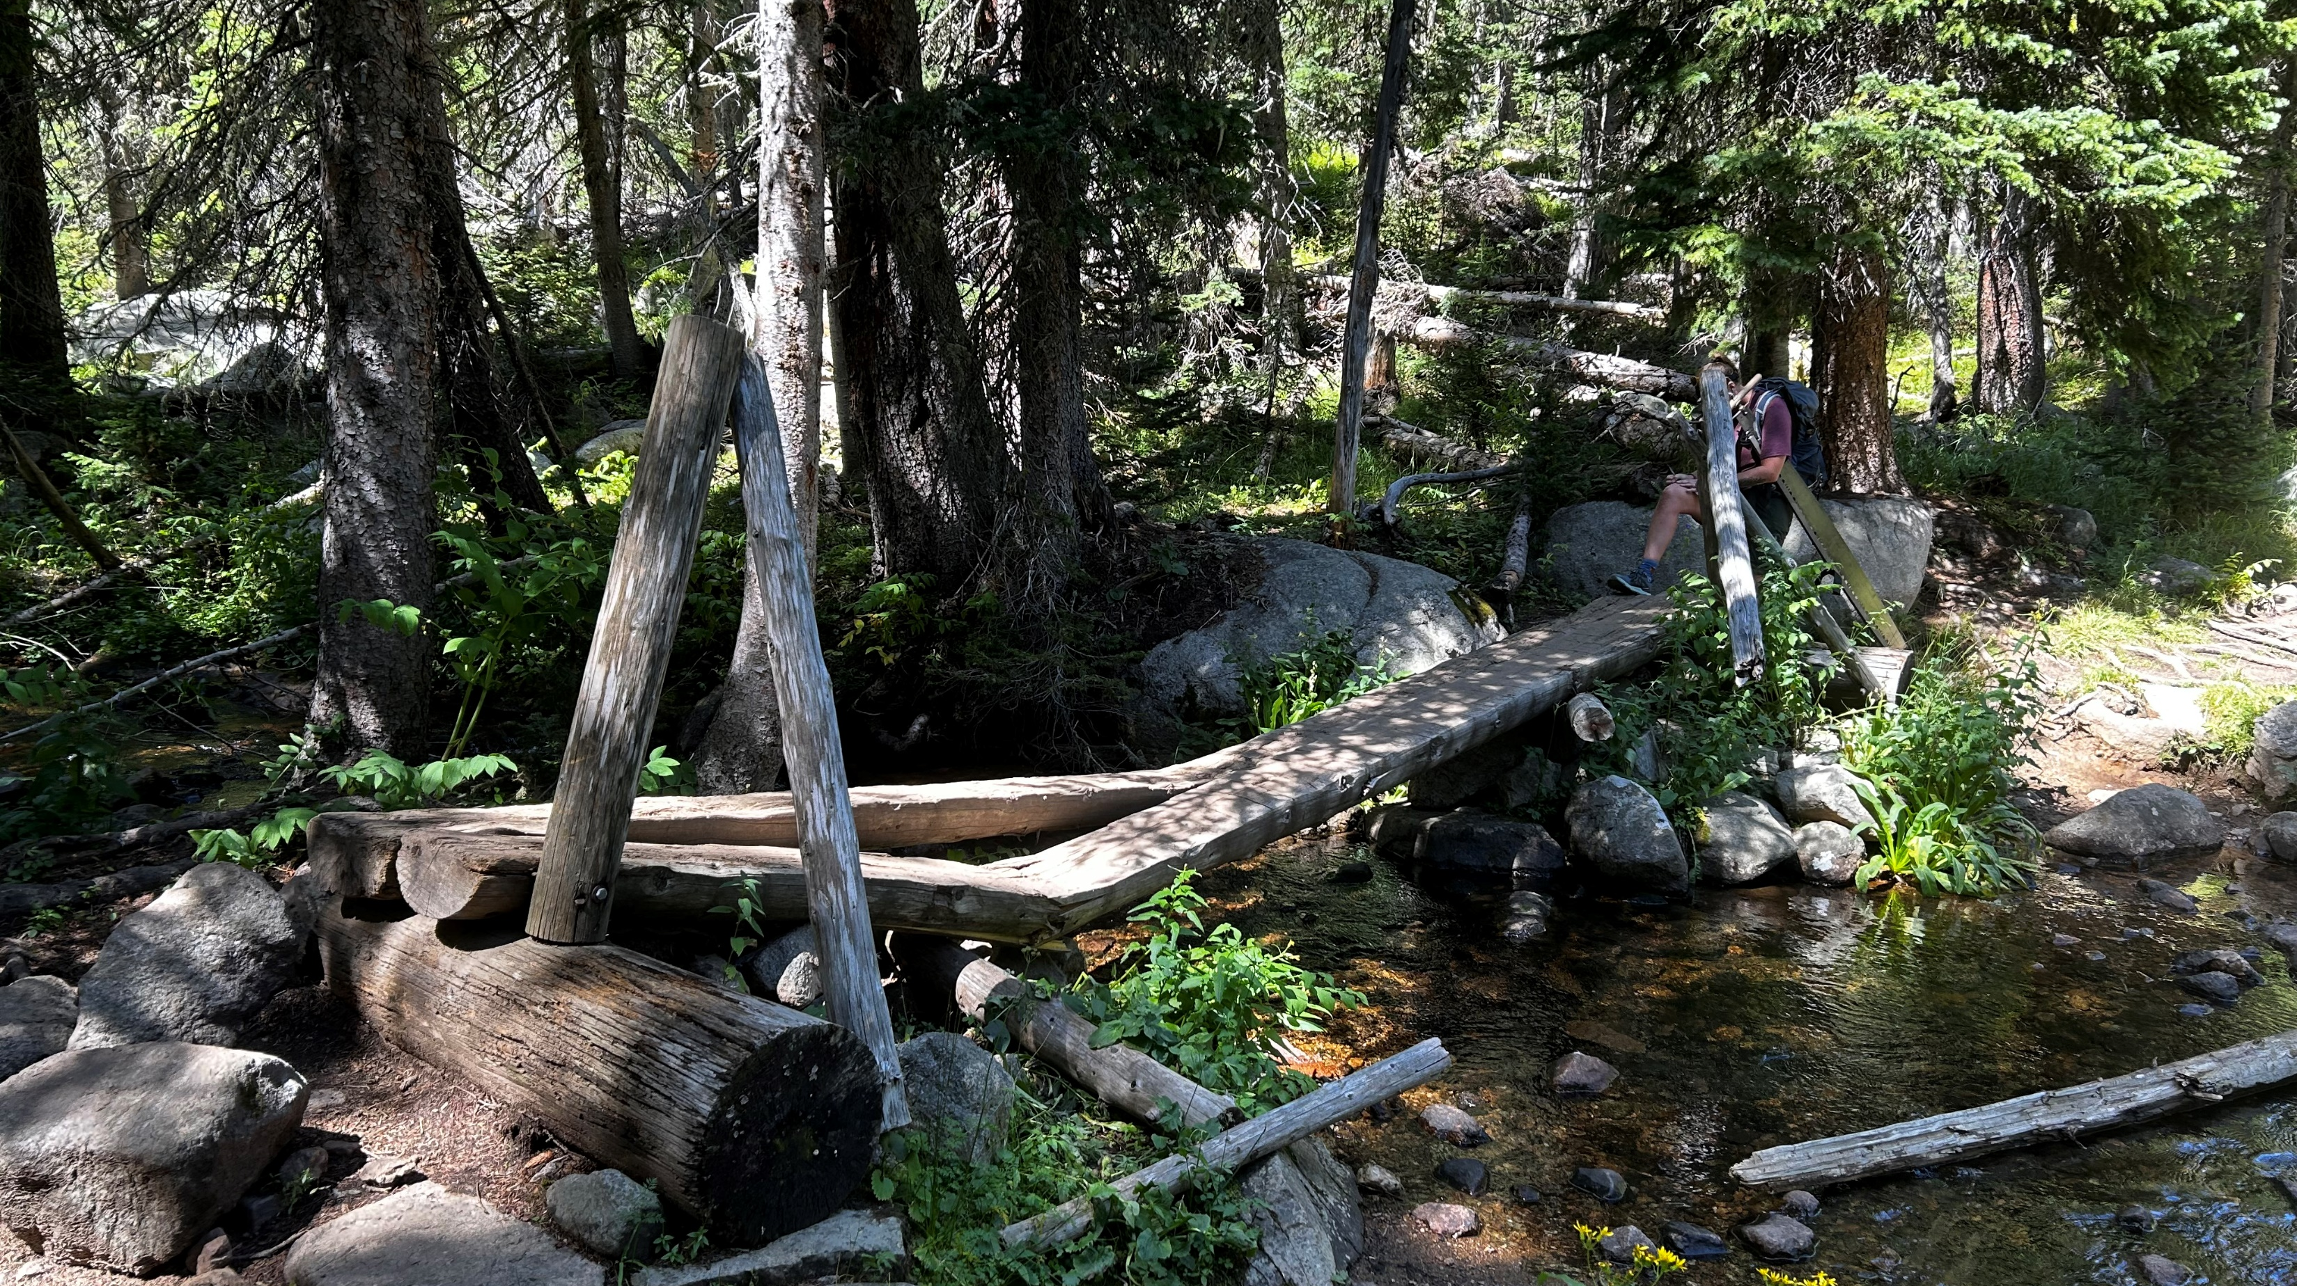

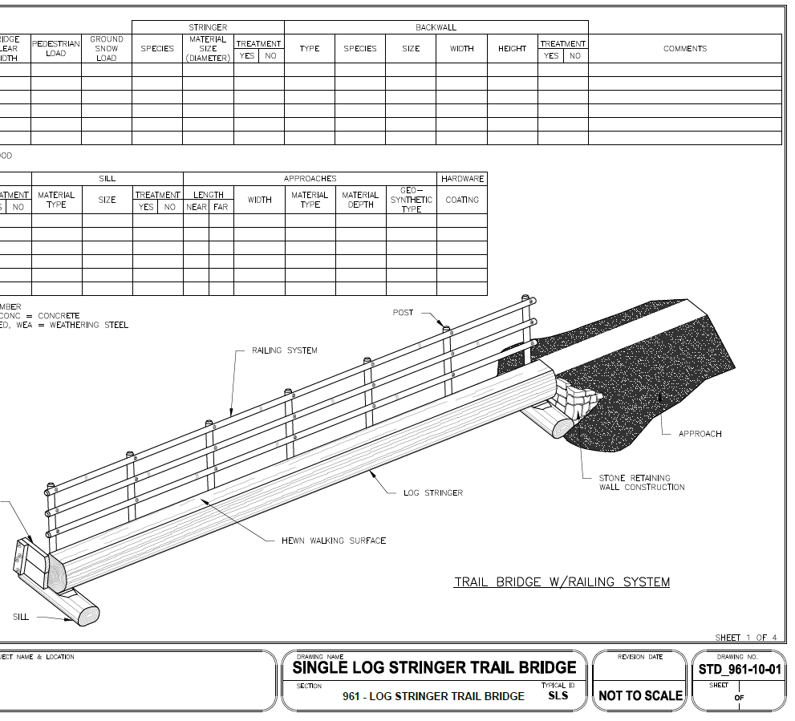
Single/Double Log Stringer
95% of bridges in the IPW and JPW

Slide 6
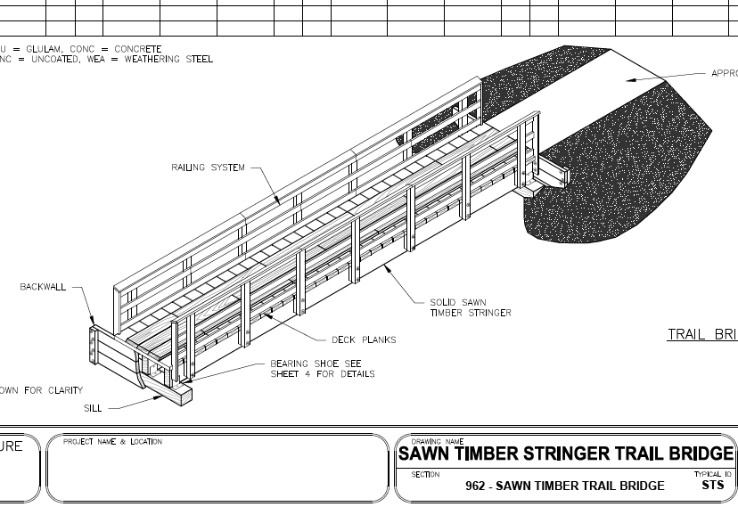
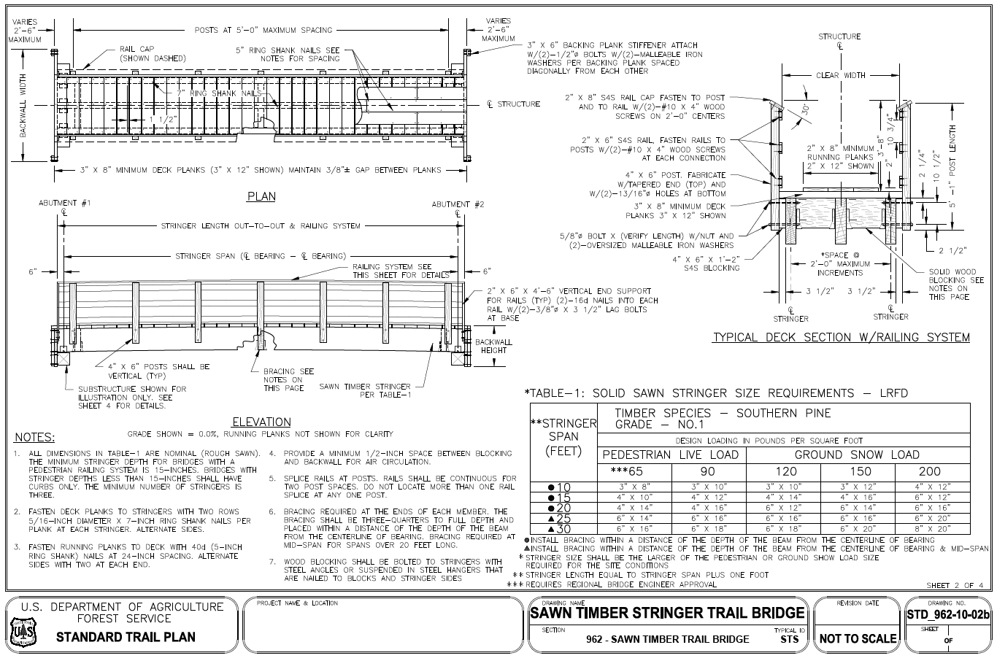
Sawn Timber Trail Bridge

Slide 7
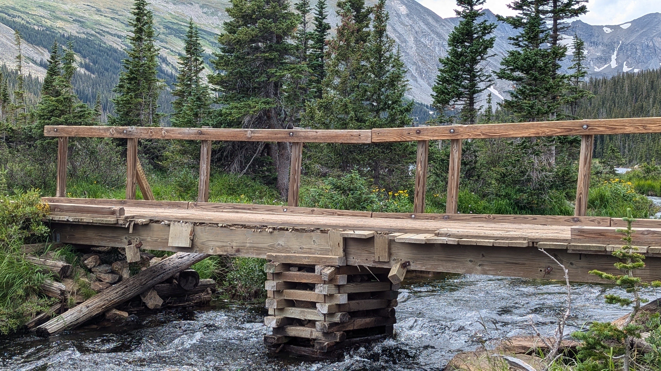
Sawn Timber Trail Bridge

Slide 8
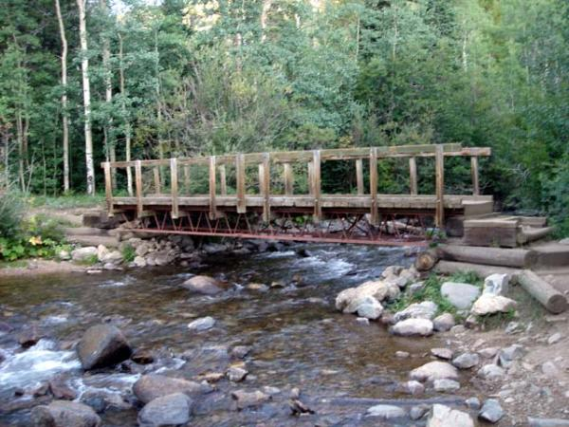
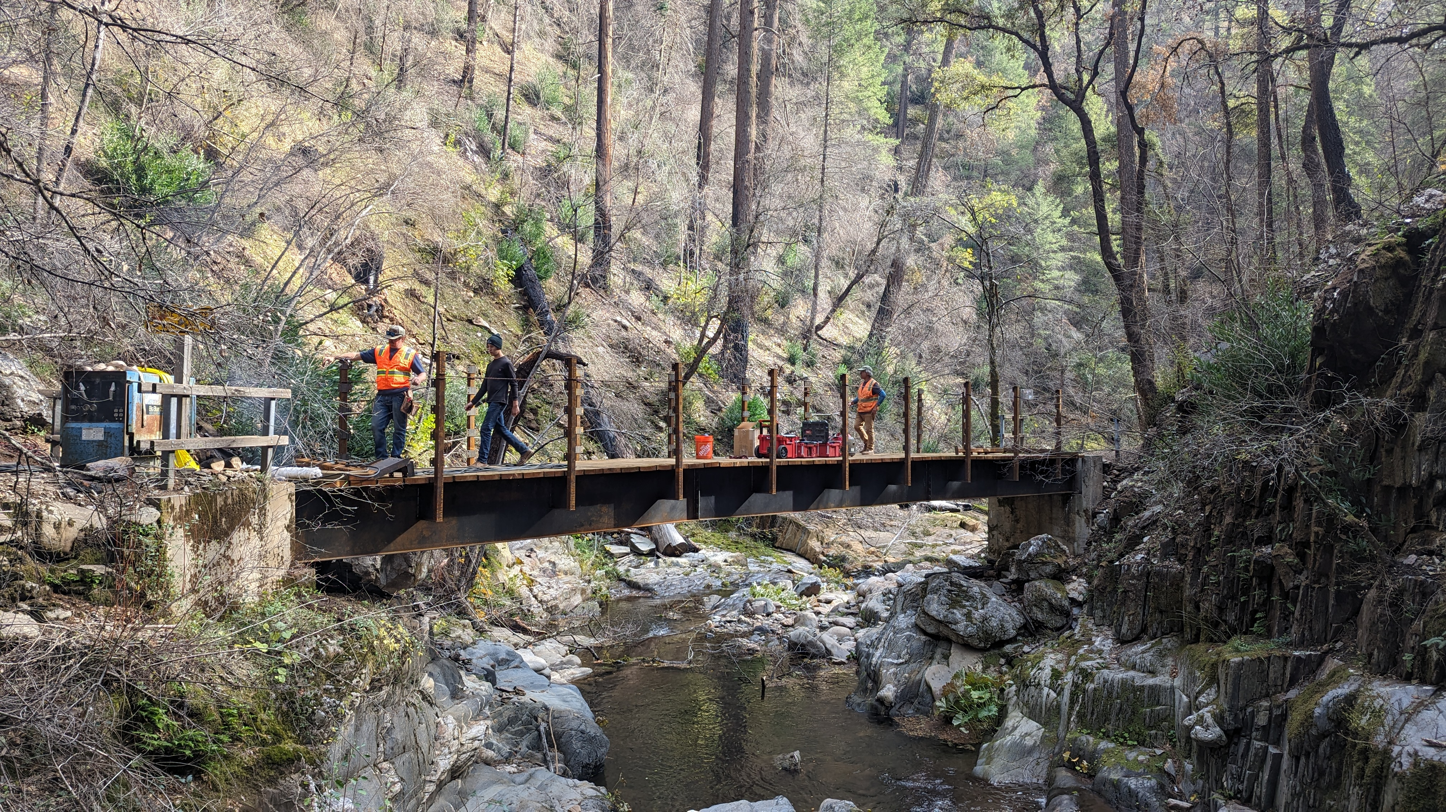
Complex Trail Bridges
Hessie TH, Buchanan Pass Trail, Coney Flats TH

Slide 9
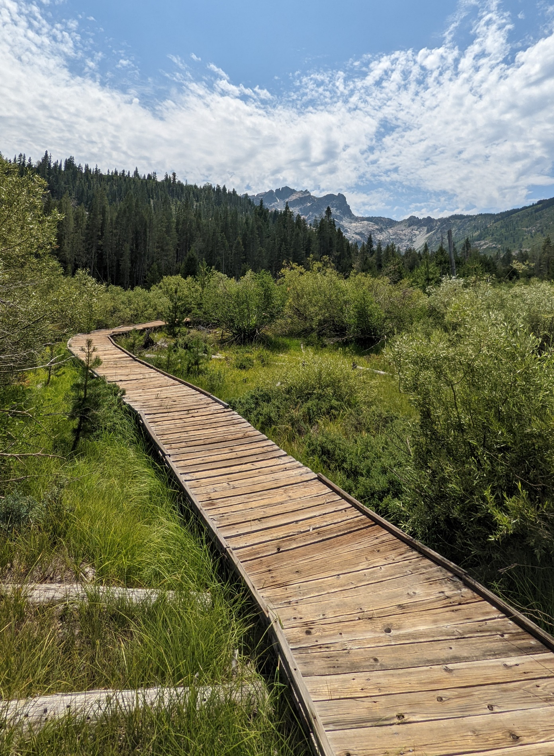
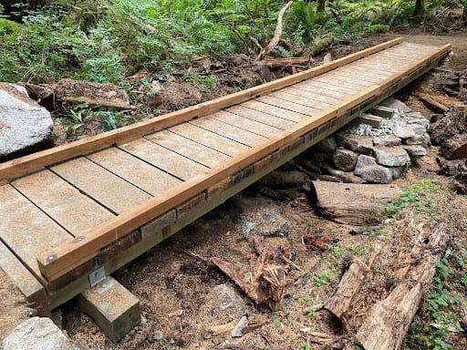
Puncheon/Boardwalk
Not really looking for surveys on these, but if you find one in disrepair then please log it!

Slide 10


CMC RIMS App
Colorado Mountain Club designed the RIMS app in 2019 to help land managers collect and utilize crowdsourced data to better understand and address critical issues related to recreation and natural resources.
RIMS (Recreation Impact Monitoring System) is the data collection tool which includes GPS data, detailed surveys, photos, editing and sharing features, and offline functionality
RIMS is capable of trail maintenance needs, visitor use surveys and more, but we’re only focused on bridge surveys as IPWA already has a trail condition reporting process.
iPhone
Android

Slide 11
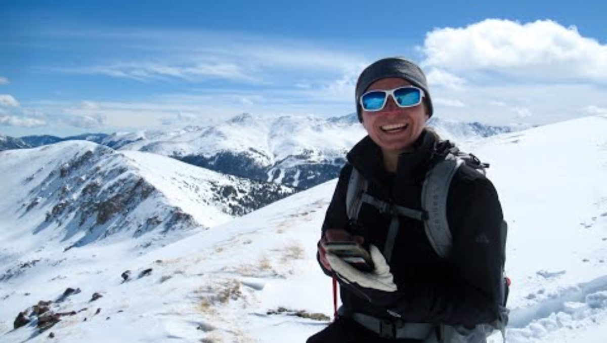
How to Use RIMS

Slide 12
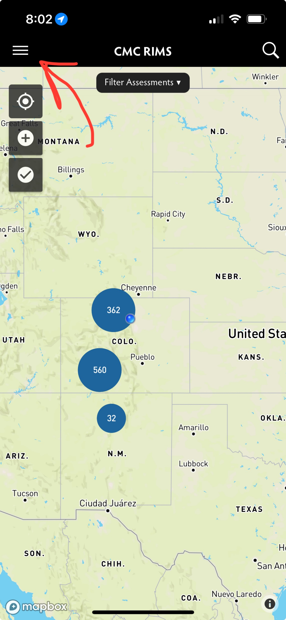
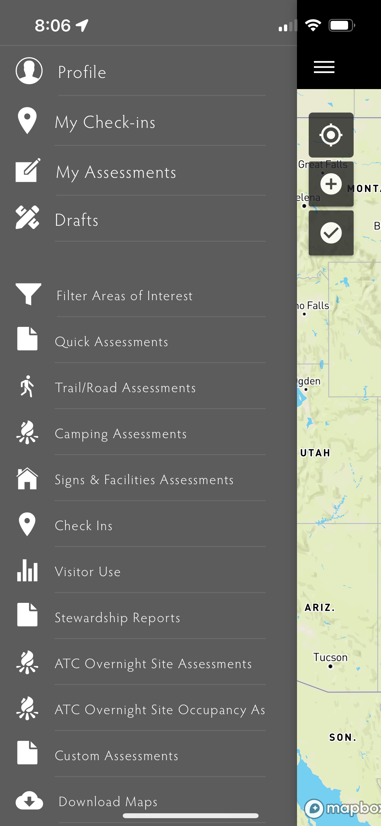
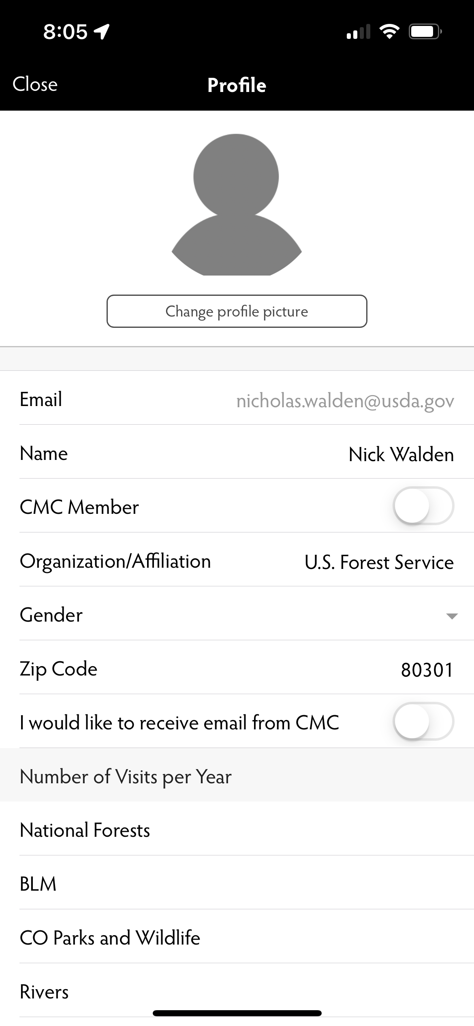
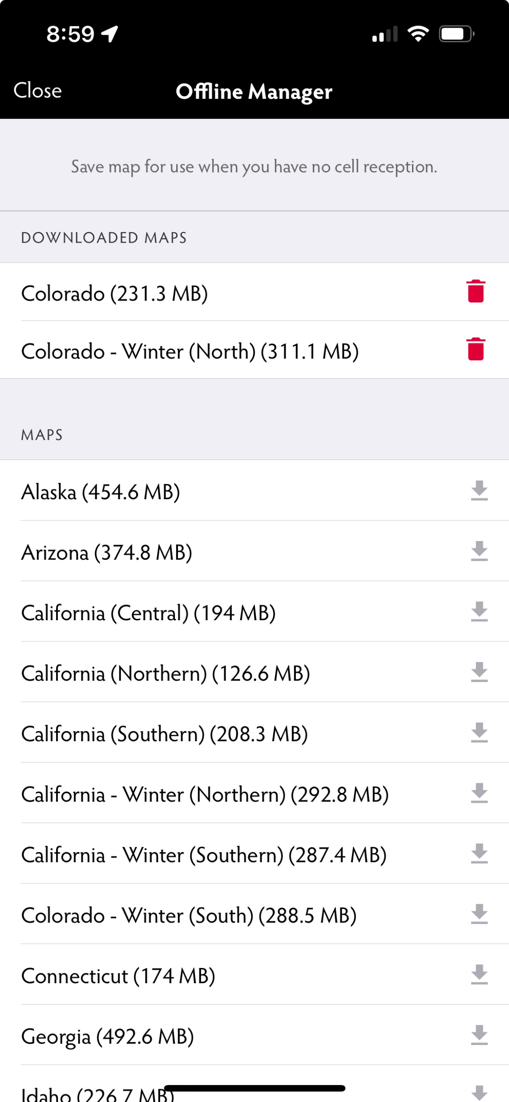



Setting up RIMS
Click on menu
Click on profile
Enter info and save
Click on Menu again, scroll to “Download Maps” and click on Colorado

Slide 13

Quiz!
To fill out assessments, everyone will need to take the quiz. Located at Data Collection — The Colorado Mountain Club – All answers in previous video

Slide 14
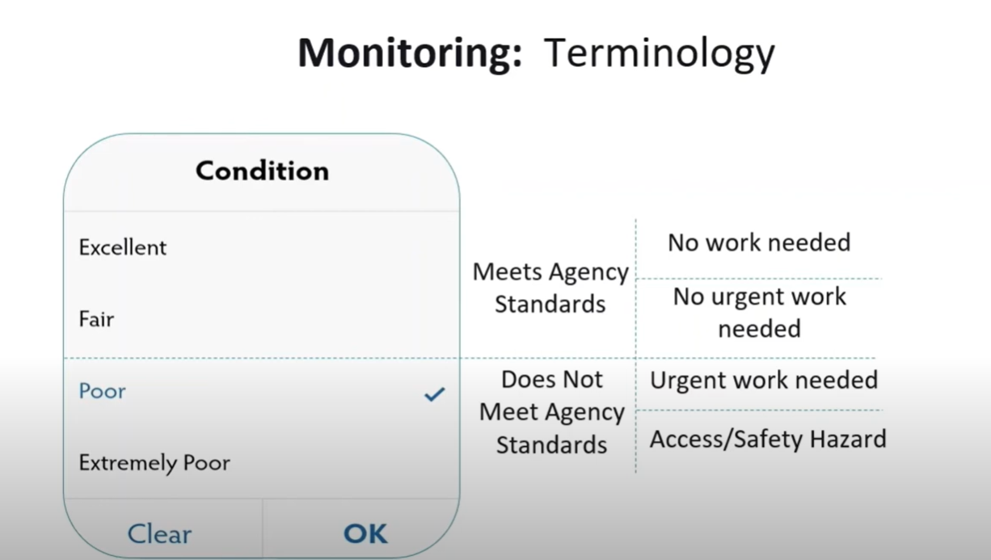

Slide 15
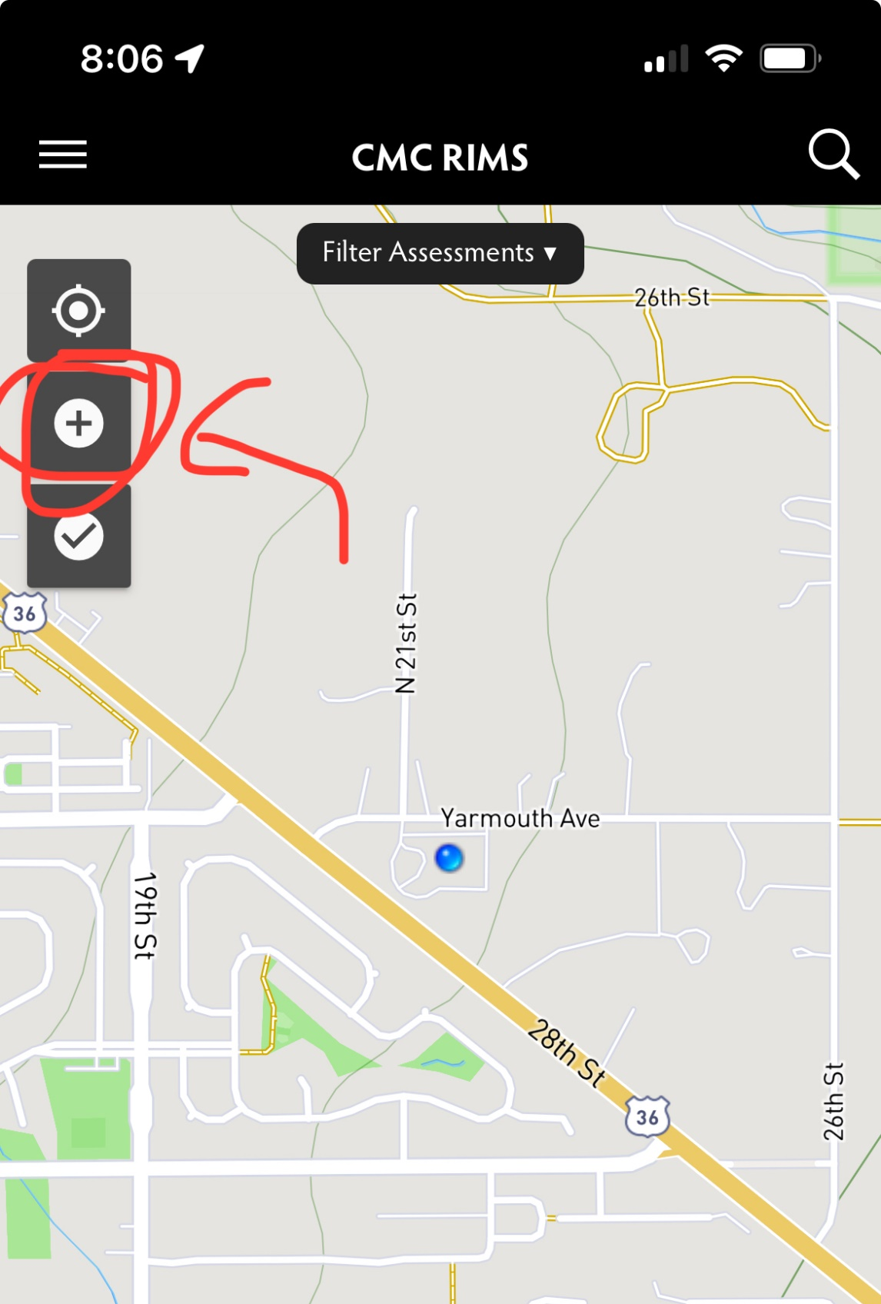
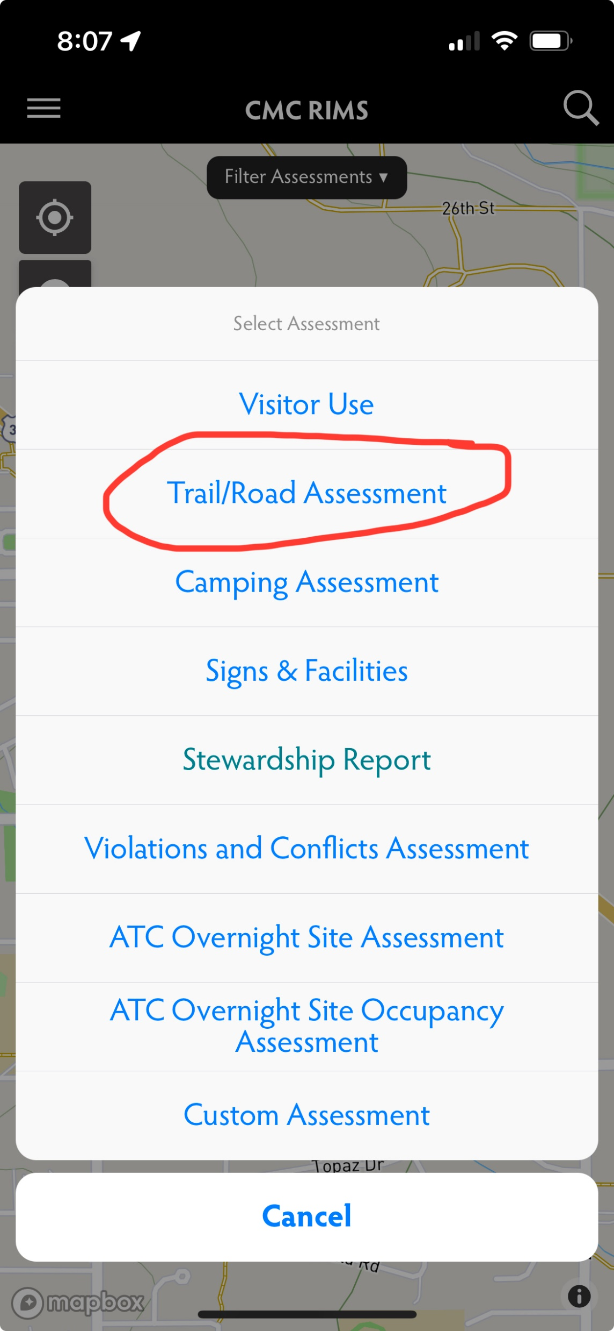
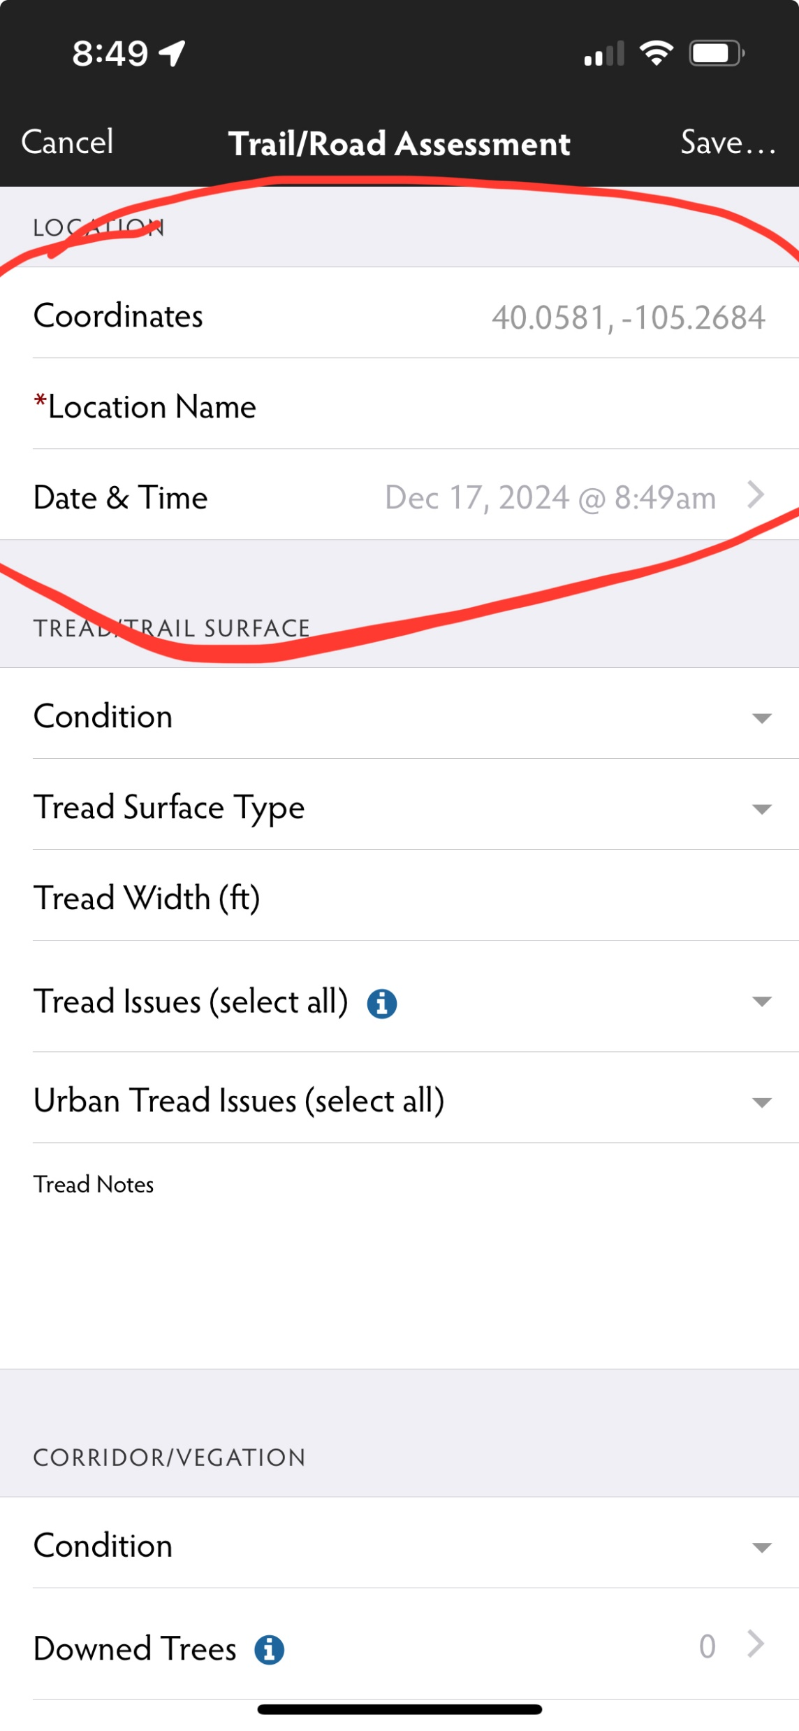
Bridge Surveys with RIMS
Make sure to check if there’s already a survey for the bridge!

Slide 16
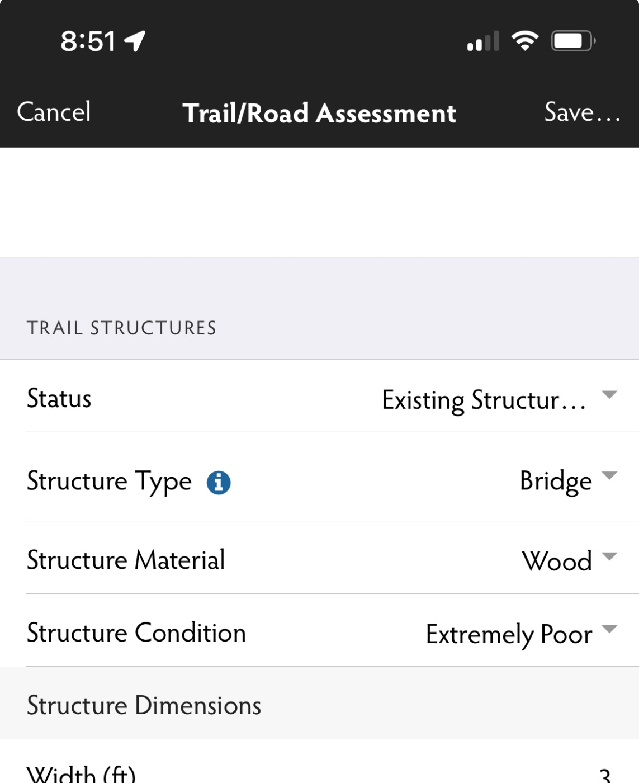

Bridge Surveys Continued

Slide 17
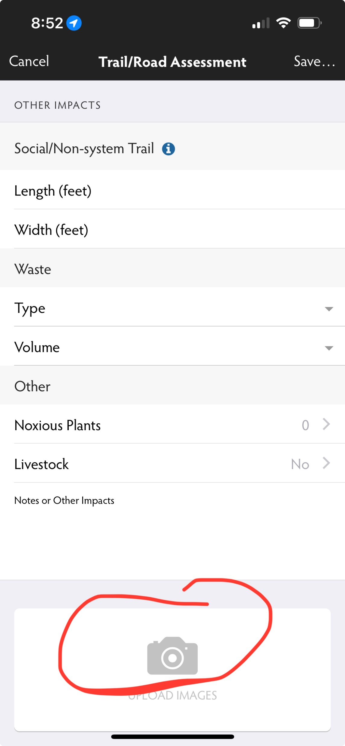
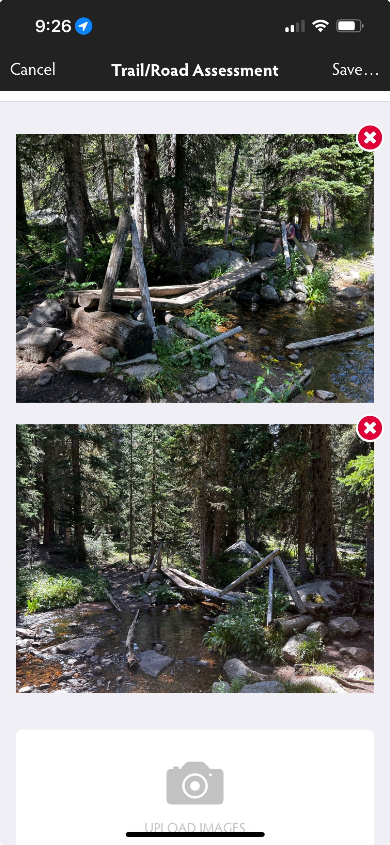
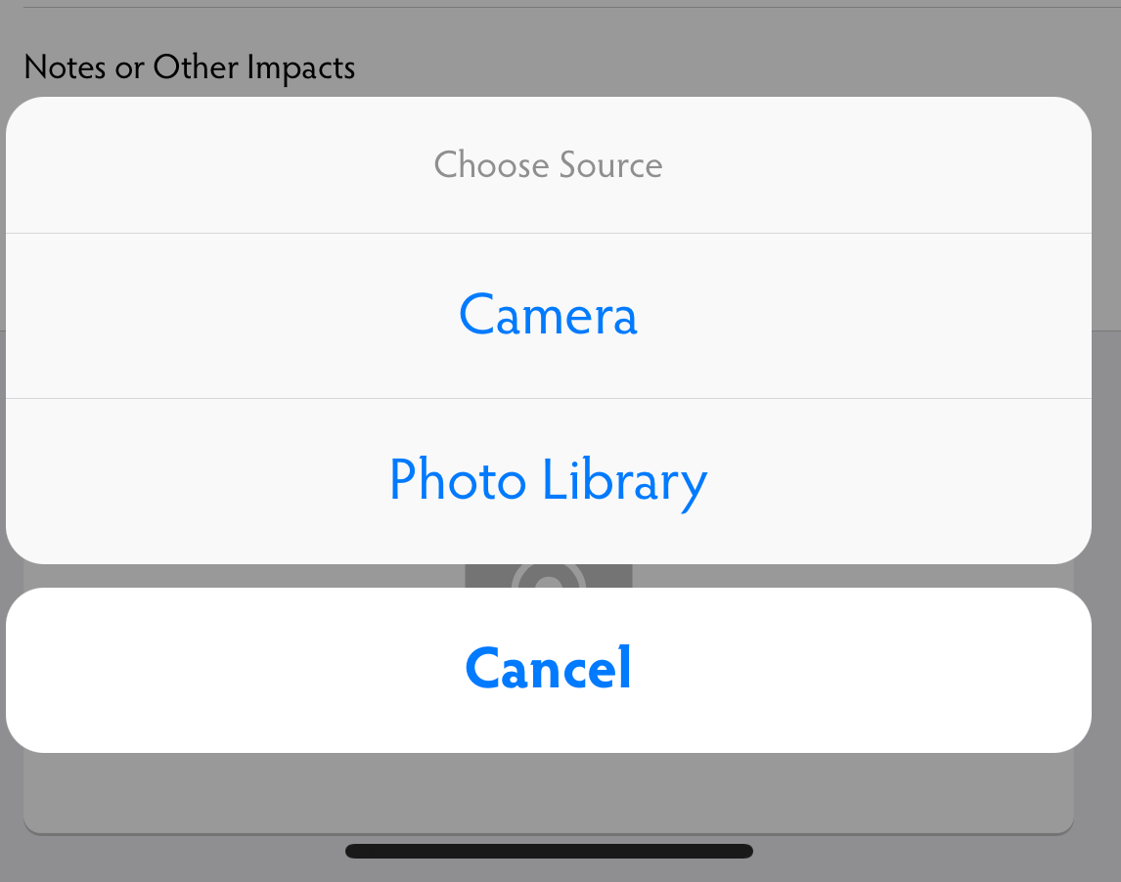

Photos of Bridges
Most Important Part!

Slide 18
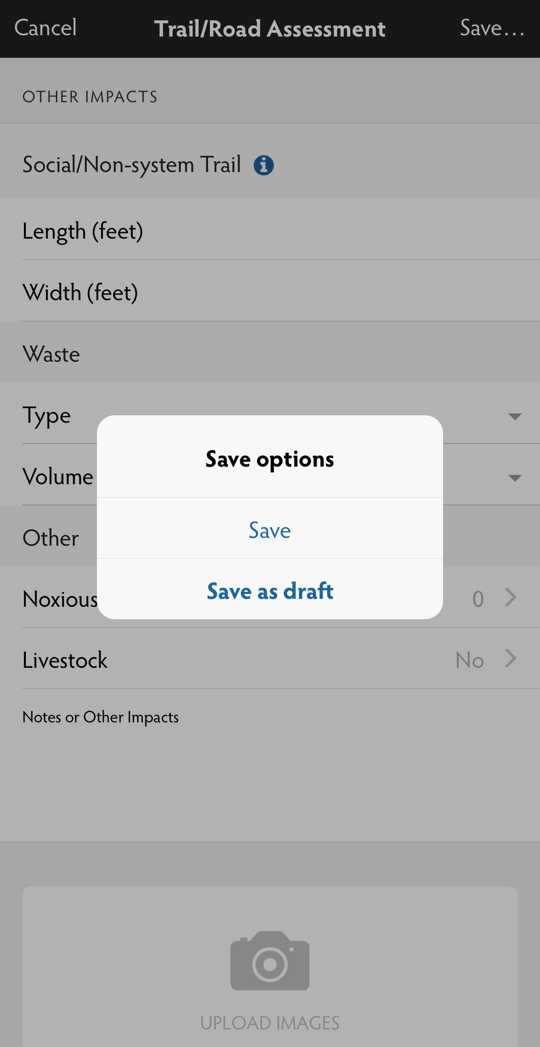
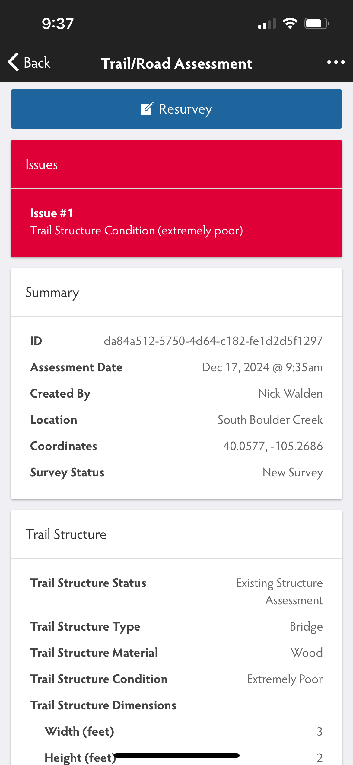
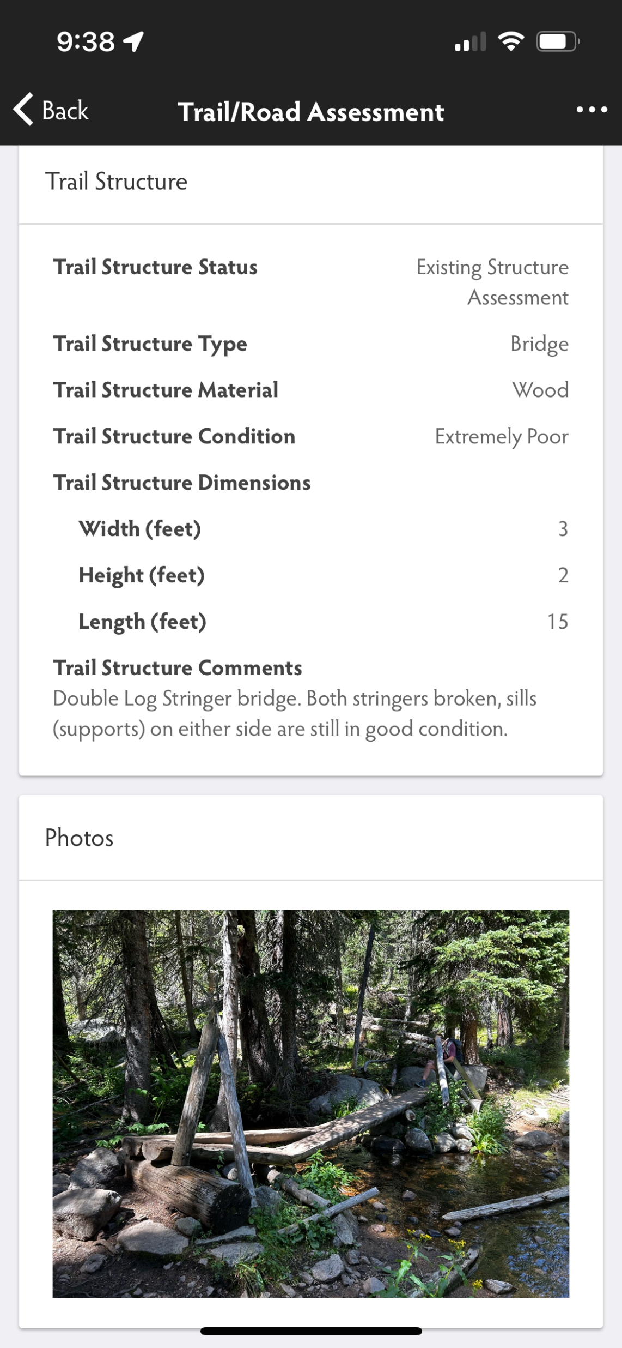
Finishing Up

Slide 19
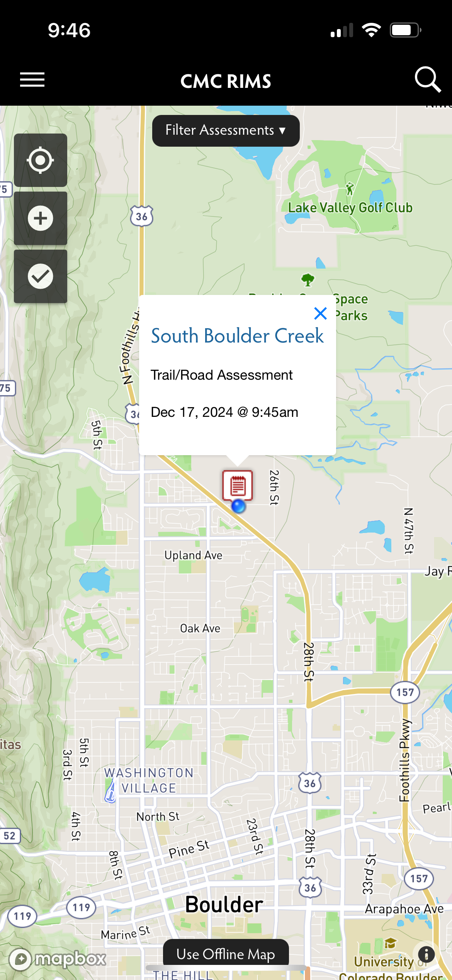
View Completed Survey

Slide 20
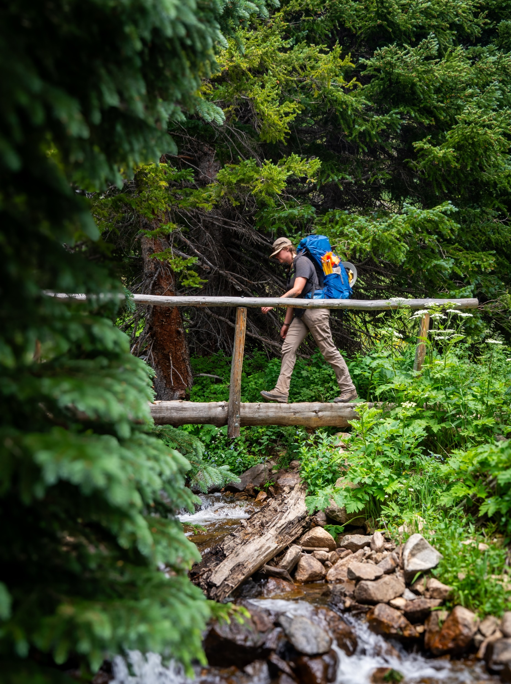
Questions and Practice

